Slide 1
Modeling Recruitment in Stock Synthesis

Slide 2
Outline
Spawner-recruit curves
Temporal variation
  deviates
  bias correction
  autocorrelation
  initial recruitment
Covariate
Recruitment cycles
Fecundity

Slide 3
Spawner-recruit curves
Beverton-Holt
Beverton-Holt with flat-top beyond B₀
Ricker
CAGEAN
  estimated parameter for each recruitment
  no distributional assumption
Survival-based
  constrained so that the recruitment rate cannot exceed fecundity
Shepard 3 parameter

Slide 4
Importance of Third Parameter
B-H and Ricker 2 parameter curves force Bmsy to be <50% of Bzero (e.g. K), and often near 30%
2 parameter biomass dynamics models force Bmsy to equal 50% of K.
Hence, age-structured models and biomass dynamics models produce advice with structural difference
3 parameter SRR allows for alignment of the approaches

Slide 5

Spawner-Recruitment in SS
f(SSB,env) provides arithmetic mean recruitment
Dev_{y} is the estimated recruitment deviation in year, y
A_{y} is the specified fraction of the bias adjustment to apply in year, y, such that E(mean R) is unbiased
  A_{y} goes to 1.0 where data are perfectly informative about recruitment deviations (0.85 is typical max)
  A_{y} goes to 0.0 where there are no data to inform model about recruitment deviations

Slide 6
Virgin, e.g. Unfished
Virgin recruitment (R₀) scales the spawner-recruitment curve and the unfished abundance level where SSB₀ = R₀ * SPR₀

Slide 7
Initial Age Composition
The recruitment used for “initial equilibrium” with optional offset and environmental effect
  R₁ = R₀ * exp(offset)*exp(linkparm*env)
Set F=init equilibrium F
Get SPR for this F
Optional:
  Adjust R1 based on SPR that comes from this F
Calc initial equilibrium abundance, catch and initial age structure
Adjust initial age structure with early rec_devs

Slide 8
Covariates
Recruitment can be modeled as a function of a covariate (i.e. environmental index):
As a multiplicative factor applied to value drawn from the stock-recruit curve
As an adjustment to the stock-recruit curve
  Virgin recruitment (R₀) is a function of the covariate
  Steepness (h) is a function of the covariate

Slide 9
Annual Recruitment
Adjust R0, B0, steepness for env effects
Get newrecruits = f(B, adjusted R0, B0, steepness)
Adjust for env
Adjust for recdev_cycle
Adjust for bias adjustment
  NewRecruits*=mfexp(-biasadj(y)*half_sigmaRsq)
Adjust for deviation
  NewRecruits*=mfexp(recdev(y))

Slide 10
Annual recruitment deviations
Essentially treating recruitment as random effect
Constrained so they average zero
  constraint optional, but interpretability of reference points depends on central tendency = 0
Distribution assumed to be lognormal and the standard deviation (σ_{R}) of the distribution is an estimable parameter
May be autocorrelated

Slide 11
Spawner-Recruitment Setup
#_Spawner-Recruitment
3 #_SR_function: 2=Ricker; 3=std_B-H; 4=SCAA; 5=Hockey; 6=B-H_flattop; 7=survival_3Parm; 8=Shepard_3Parm
#_LO HI INIT PRIOR PR_type SD PHASE
6 9 7.03871 10 -1 10 1 # SR_LN(R0)
0.2 0.99 0.8 0.8 -1 0.15 -7 # SR_BH_steep
0.2 2 0.533132 0.3 -1 0.3 3 # SR_sigmaR
-5 5 0 0 -1 1 -3 # SR_envlink
-1 1 0 0 -1 1 -3 # SR_R1_offset
-1 1 0 0 -1 1 -3 # SR_autocorr
0 #_SR_env_link
0 #_SR_env_target_0=none;1=devs;_2=R0;_3=steepness
1 #do_recdev: 0=none; 1=devvector; 2=simple deviations
1972 # first year of main recr_devs; early devs can preceed this era
2013 # last year of main recr_devs; forecast devs start in following year
3 #_recdev phase

Slide 12
Recruitment deviation eras
Can have rec devs before first year of model to populate initial age structure
Can be broken into three vectors
  early, main, forecast
  only main vector is zero-centered
  prevents zero-centering of main vector from influencing recruitments in years which should be totally uninformed by data (i.e. forecast)

Slide 13
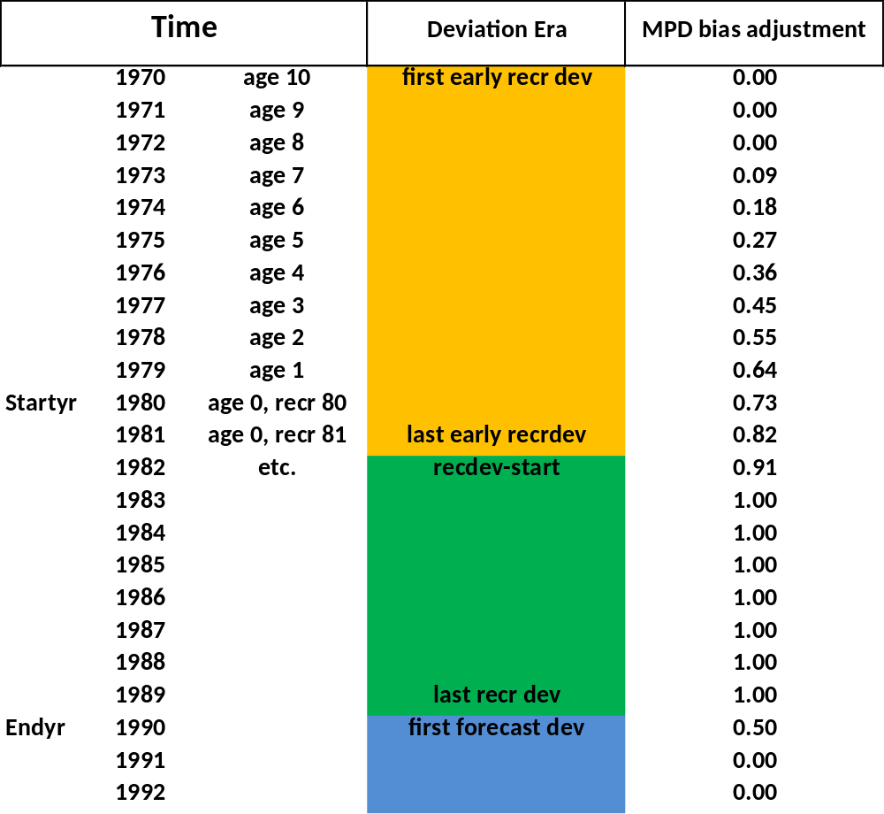
Recruitment Eras

Slide 14
Spawn-Recruit Output
SPAWN_RECRUIT | Function: | 3 | _ | _ | _ | _ | _ | _
7.21262 | Ln(R0) | 1356.45
0.8 | steep
0.306667 | Bmsy/Bzero
0.377533 | sigmaR
0 | env_link_
0 | init_eq | 1356.45
1972 | 2013 | main_recdev:start_end
1974.8 | 1978.6 | 2012.1 | 2016.1 | 0.903 | breakpoints_for_bias_adjustment_ramp
ERA | N | RMSE | RMSE^2/sigmaR^2 | mean_BiasAdj
main | 42 | 0.335569 | 0.790051 | 0.786136
early | 22 | 0.043627 | 0.013353 | 0
year | spawn_bio | exp_recr | with_env | adjusted | pred_recr | dev | biasadj | era
S/Rcurve | 5666.21 | 1356.45
Virg | 5666.21 | 1356.45 | 1356.45 | 1356.45 | 1356.45 | - | 0 | Virg

Slide 15
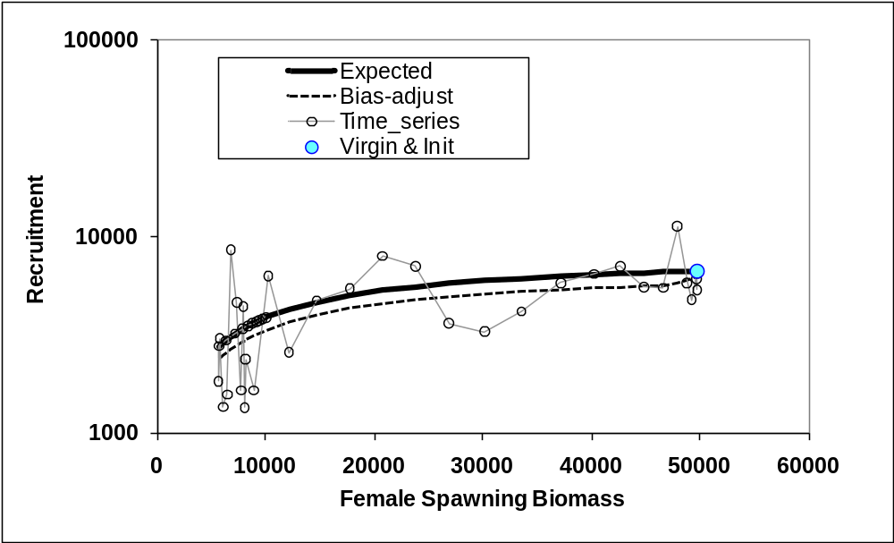
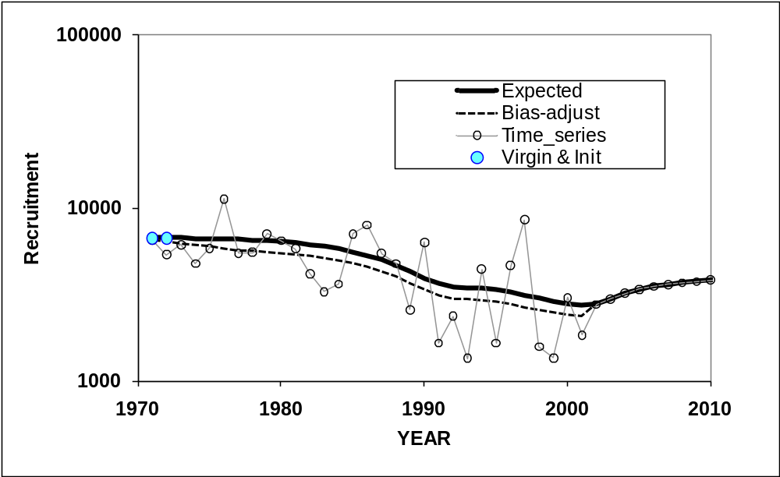
Recruitment in SS

Slide 16
Advanced S-R options
1 # (0/1) to read 13 advanced options
1950 #_recdev_early_start (0=none; neg value makes relative to recdev_start)
3 #_recdev_early_phase
0 #_forecast_recruitment phase (incl. late recr) (0 value resets to maxphase+1)
1 #_lambda for Fcast_recr_like occurring before endyr+1
1974.8 #_last_early_yr_nobias_adj_in_MPD
1978.6 #_first_yr_fullbias_adj_in_MPD
2012.1 #_last_yr_fullbias_adj_in_MPD
2016.1 #_first_recent_yr_nobias_adj_in_MPD
0.903 #_max_bias_adj_in_MPD (-1 to override ramp and set biasadj=1.0 for all estimated recdevs)
0 #_period of cycles in recruitment (N parms read below)
-5 #min rec_dev
5 #max rec_dev
0 #_read_recdevs
#_end of advanced SR options

Slide 17
Bias correction
Added to the temporal deviate to make the recruitments mean unbiased.
Only appropriate in a penalized likelihood context where there is sufficient information about recruitment
Options available to reduce the bias correction in early and late years with little information about recruitment
See paper by Methot & Taylor on bias correction

Slide 18
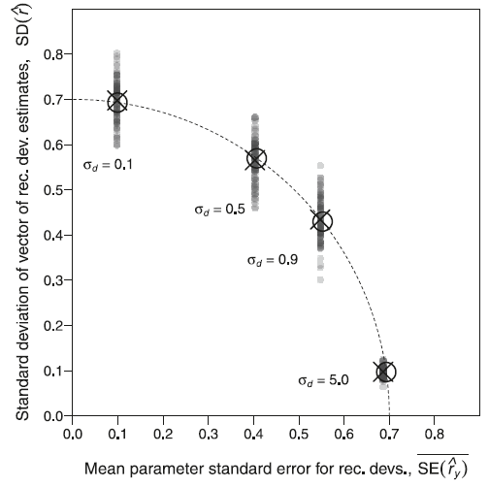

Recruitment – partitioning variance
Bias Adjustment =
Based on a simple model in which only data is a timeseries of a recruitment survey (so no age data)

Slide 19
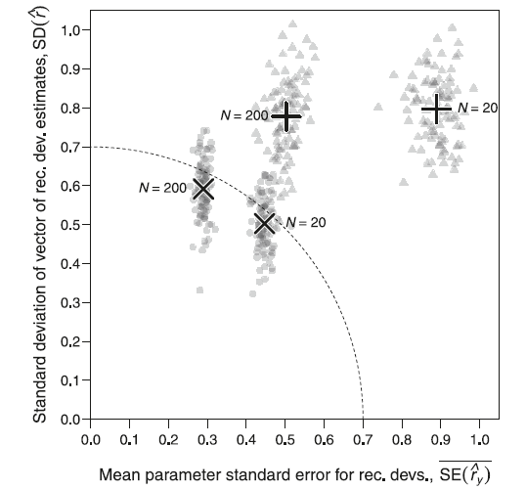
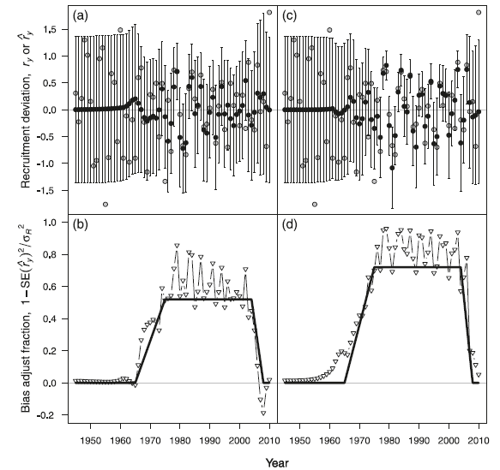
Bias Adjustment in Age Structured Models
In Figure above, triangle is for SCAA, circle is for SS with recruitment penalty

Slide 20
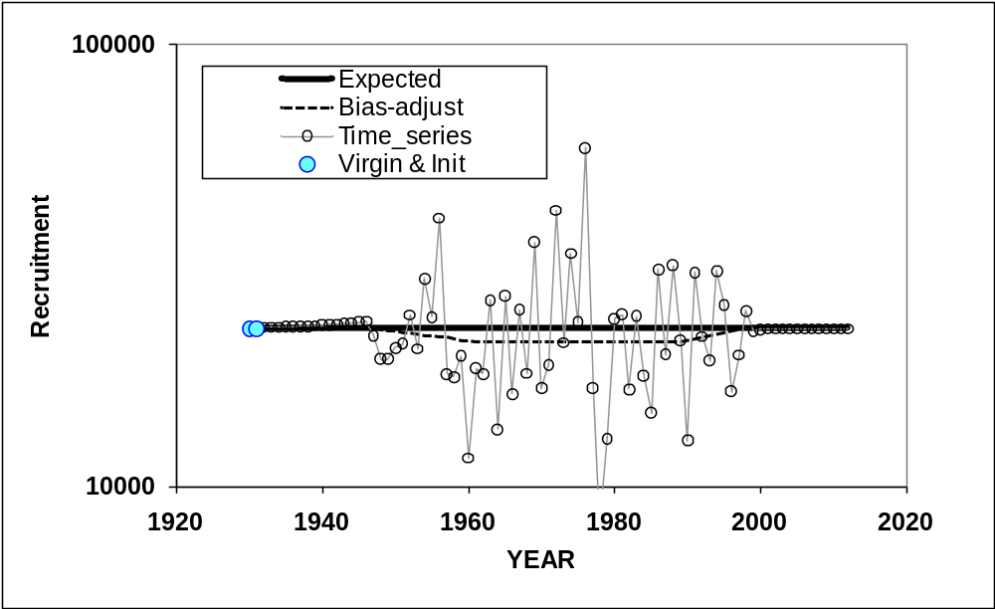
Longer Example Showing Bias Ramp
Data Era

Slide 21
Recruitment indices
An alternative approach instead of modeling recruitment deviates as a function of covariates
Selectivity options allow inclusion of indices of
  recruitment
  recruitment deviation
  exp(recruitment deviation)
  exp(recruitment deviation)*Spawning Biomass
  (i.e. pre-recruit survey before density dependence)
Fit of model to recruitment indices depends on variability of index values

Slide 22
Seasonal models
Models with seasons within year can specify which seasons have recruitment
  separate cohorts for each “birth season”
  parameters for fraction of total annual recruitment distributed to each season
Models that use season as the time step (redefine year as season) can use cycles
  vector of estimated recruitment deviates
  exponentiated parameters centered around 1

Slide 23
Other divisions of recruits
Spatial models:
  global recruitment distributed among areas
  parameters for fraction of total annual recruitment distributed to each season
  (similar to seasons within years)
  May model deviates around distribution parameters
Growth patterns
  may define separate growth patterns and distribute recruitment between them
  growth patterns can be assigned separate areas or movement patterns in spatial models

